Slide 1
ETL with R
Filip Rodik
Code For Croatia / Gong

Slide 2
ETL
Extract – Transform – Load
Incremental process
Wizard stuff
Relational DB
CSV, Excel
API, JSON
DWH

Slide 3
Extract
Reading various data sources
Common problems
Drivers
Encoding horror
CSV properties (headers, separator, quotation, file size …)
XML structure
JSON structure
Includes data-source analysis

Slide 4
Transform
Data type conversions
Cleaning – Belgrade vs Blegrade
Deduplication – Belgrade vs BG
Pivoting/unpivoting
Grouping data
Joining multiple sources or tables
Logging

Slide 5
Load
Insert clean data to warehouse/database
Bulk operations
Performance issues
Heavy impact on destination database

Slide 6
Mosaic of connections
Central search engine for relevant information on Politically Exposed Persons (PEPs) in Croatia
Users:
Journalists
NGOs
general public
Public beta available - www.mozaikveza.hr
Google Digital News Innovation Fund
Official release by the end of 2018

Slide 7
Mosaic of connections - data
Roles in political parties
Roles in public authorities
NGO register
Commercial court register
Nonprofit organization register
Property reports
State treasury payments
…
Freedom of Information Act (FOIA)

Slide 8
Mosaic of connections – under the hood
Complete ETL with R
Sources: csv, xml, oracle dump, excel, API
Destination: MozaikDB “relational” database (Postgres)
Pipe:
Various data sources ->
ETL ->
Postgres ->
Elasticsearch (or neo4j graph database) ->
Web

Slide 9
Graphical data piping tools
SSIS packages or (T)SQL scripts? Or both?
Advantages:
Documentation
Modular chunks
Interpretation
Disadvantages:
Slow development
Slow learning curve

Slide 10
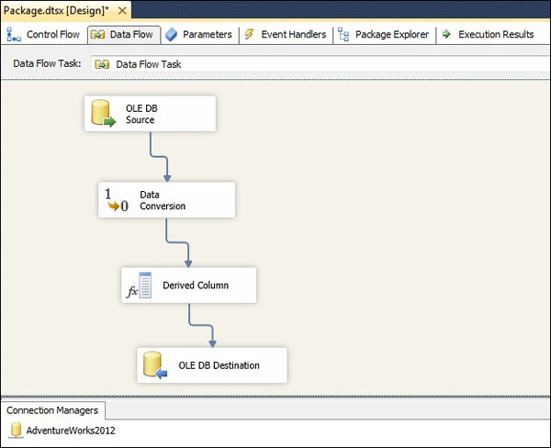

Slide 11
Data extraction options - R
base – reading flat files
tidyverse/readr – reading various sources
RODBC – ODBC connector
openxlsx – Excel files
olapR – OLAP cube connector
rjson, jsonlite – JSON files
xml2 – read xml
httr - API
ggplot2 – visualize, describe data

Slide 12
Staging zones - R
Improvise
Serialize R objects as .RDS files
Keeping track of versions?
Good compression
No indexing
Reading whole objects
Use a relational DB
Use flat files
Detecting changes on data source

Slide 13
Data transformation options - R
base
apply family
tidyverse/dplyr
magrittr pipe %>%
mutate
window functions
join functions
grouping
data.table (performance)
Stringi/stringr/snakecase – working with strings
rlist – working with lists
R supports classes

Slide 14
Data cleaning options - R
Base data conversions
Data type validation: checkmate
String functions
Fuzzy matching
agrep (base)
Packages: stringdist, fuzzyjoin, fuzzywuzzyR :)
Master data management (MDM)
No options at the moment
Mosaic cleaning logic pushed down to backend

Slide 15
Data loading option - R
httr – API used for writing to Mosaic DB
Iterative horror:
Post Entity: create entity “John Doe, OIB=12345678910” – john-doe-1
Post Attribute: last_name (string) for entity type – ‘person’
Post AttributeValue: last_name=“Doe” for entity john-doe-1
Post EntityConnection: john-doe-1 is ‘sys_admin’ at company-abc (connection ID=456)
Post ConnectionAttributeValue: conn.456 – Salary=“12345.67”
RODBC – writing to DB
Optimized bulk load

Slide 16
Conclusion
Using the “wrong” technology to solve a problem – I would do it again
R is excellent at individual steps of ETL … but …
Lacks high-level ETL process support
Staging objects
MDM
Manual logging
Visualizing data pipes
Minimal transaction support

Slide 17

Thank you!
filip@gong.hr

